Slide 1
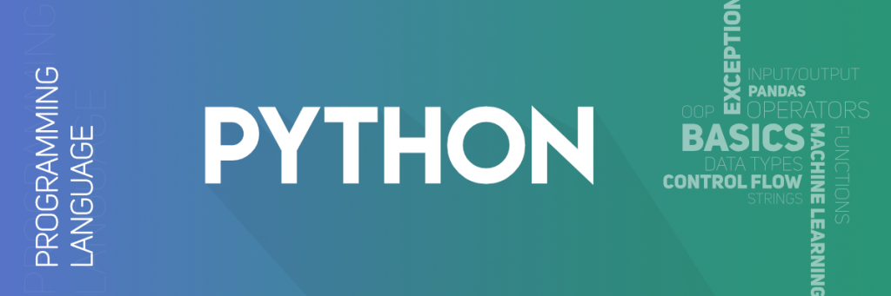

Slide 2
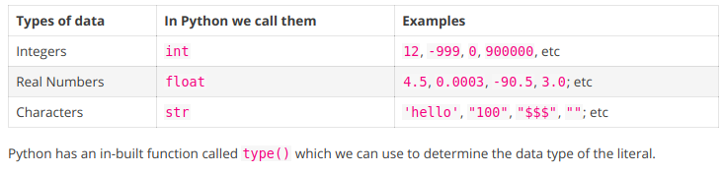
Data Types
Data Type is nothing but a categorization of data of different types.

Slide 3
>>>
>>> type(54)
<class 'int'>
>>>
>>> type("a string")
<class 'str'>
>>>
>>> type(98.188)
<class 'float'>
>>>
>>> type("3.14")
<class 'str'>
>>>
>>> type("99")
<class 'str'>
>>>

Slide 4
Variables
Variables are used to store data in our programs.
We also use variables to access data as well as manipulate data.
A variable is called so because it’s value can be changed.
Creating variables
To create a variable in Python we use the assignment statement which has the following format.
variable_name = expression

Slide 5
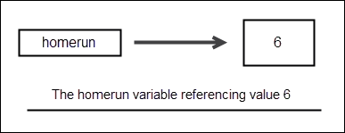
Here is an example:
1 | homerun = 6
This statement creates a variable named homerun and assigns it the value 6. When Python Interpreter encounter statements like this it does the following things behind the scenes.
Store the variable 6 somewhere in the memory.
Make variable homerun refer to it.
The important thing to understand here is that variable homerun itself doesn’t contain any value, it only refers to a memory location which contains the actual value.

Slide 6
1 2 3 4 5 6 7 8 9 10 11 12 13 14 15 16 17 | >>> >>> homerun = 6 # at this point, homerun contains an int or integer >>> homerun 6 >>> homerun = "now" # now homerun contains a string >>> homerun 'now' >>> >>> type(homerun) <class 'str'> >>> >>> homerun = 2.3 # now homerun contains a float >>> homerun 2.3 >>> type(homerun) <class 'float'> >>>

Slide 7
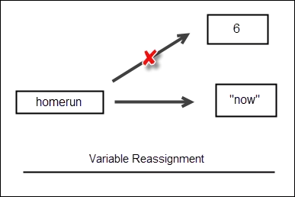
When we assign a new value to a variable the reference to old value is lost.
For example, when "now" is assigned to the homerun, the reference to value 6 is lost.
At this point, no variable is pointing to that memory location.
When this happens Python Interpreter automatically removes the value from the memory through a process known as garbage collection.

Slide 8
NameError
If you try to access a variable before assigning any value to it. You will get NameError error like this:
>>>
>>> age
Traceback (most recent call last):
File "<stdin>", line 1, in <module>
NameError: name 'age' is not defined
>>>

Slide 9
Variable Names
In Python, we have the following rules to create a valid variable name.
Only letters ( a-z, A-Z ), underscore ( _ ) and numbers ( 0-9 ) are allowed to create variable names, nothing else.
Variable name must begin with an underscore ( _ ) or a letter.
You can’t use reserved keywords to create variables names (see Next Slide).
A variable name can be of any length.
Python is a case-sensitive language which means that HOME and home are two different variables.

Slide 10
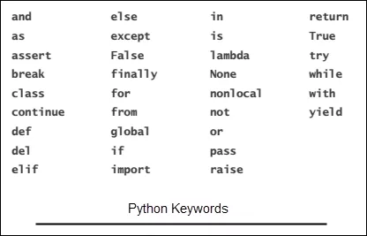
Python keywords
Python Keywords are words that denote something specific in a Python language.
That’s why we are not allowed to use them as variables names.
Here is the list of Python keywords:

Slide 11
The following are some valid and invalid variable names:
home4you – Valid after_you – Valid _thatsall – Valid all10 – Valid python_101 – Valid
$money – Invalid, variables can’t begin with $ character hello pi – Invalid, variables can’t have spaces between them 2001 – Invalid, variables can’t begin with a digit break – Invalid, keyword can’t be a variable name

Slide 12
Comments

Slide 13
Numbers in Python
In Python, Numbers are of 4 types:
Integer.
Floating Point or Real Numbers.
Complex Numbers.
Boolean.

Slide 14
Integers or int for short are the numbers without a decimal point. for example, 100, 77, -992 are int but 0.56, -4.12, 2.0 are not.
Floating point or real or float are the numbers which have decimal point. For example, 1.2, 0.21, -99.0 are float but 102, -8 are not
Python uses special syntax to write numbers in Scientific notation. For example, 0.000000123 can be written as 1.23E-7. The letter E is called exponent and it doesn’t matter whether you use e or E.
Complex numbers are the numbers which we can’t represent on a number line. A Complex number is of the form a + ib, where a is the real part and bi is the imaginary part.
For example, 2 + 3i is complex number. Python uses a special syntax for complex numbers too. An integer or float with trailing j is treated as a complex number in Python, so 10j, 9.12j are complex numbers.

Slide 15
>>>
>>> type(5) # an integer
<class 'int'>
>>>
>>> type(3.4) # a float
<class 'float'>
>>>
>>> type(5j) # a complex number
<class 'complex'>
>>>

Slide 16
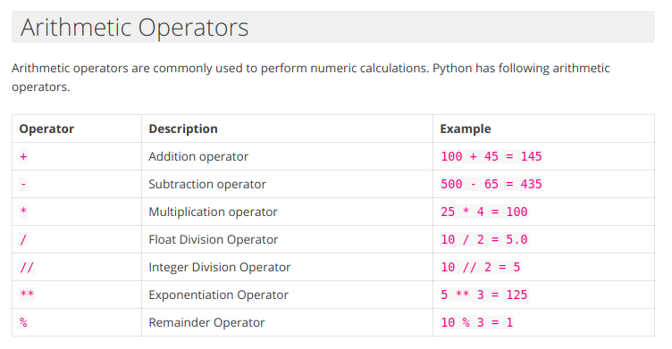
Operators in Python

Slide 17
Strings in Python
https://overiq.com/python-101/strings-in-python/

Slide 18
